Slide 1
Tool Providers

Slide 2
Overview
Who are Tool Providers?
Why are Tool Providers important?
Impact of Tool Providers
Tool Provider Services
Search campaign set up and management
Marketing strategy integration
Reporting and tracking

Slide 3
Who are Tool Providers?
Advertisers may directly manage their accounts through available Microsoft Network provided tools, or utilize third-party tool providers
A tool provider is third party service providers used to manage some or all aspects of an advertiser’s account like building advertising campaigns, reporting tools etc.
Tool providers aren’t necessarily billed directly as they’re primarily a service provider. The advertiser that owns the accounts, is billed directly by Microsoft Network. The tool provider is compensated through fees by their advertiser pool
Major Tool Providers that linked with Bing Ads are:
Marin
Kenshoo – experts in providing business algos
Adobe – good for insights
DoubleClick- good in delivering performance reports
Amazon doesn’t need tool providers ,they have their own tech

Slide 4
Why are Tool Providers Important?
Tool Providers help advertisers by providing:
Scalable Campaign Management and Reporting
Easy to use, all-in-one KPI tracking and reporting
Retargeting users who have demonstrated strong intent
Better User experience
Provide friendly Graphical User Interface (GUI)
Scalable bulk edit and campaign cloning functionalities tools
Faster Optimization Algorithm
Predict and adjust bids for more accurate bidding
Enable more effective budget spend
Tool Providers influence about 56% of the Total Yahoo Bing Network (YBN) revenue
Tool Providers help in exposing better user experience to advertisers with Bing

Slide 5
Why are Tool Providers Important?
They manage a large proportion of Strategic and Enterprise advertisers
Provide market competitive data
TPs have access to cross platform data and can give an unbiased views
Provide free whitepapers and reports – customers value their insights
Can be advocates of Bing Ads
Become potential partners as:
They are well informed on the differences between platforms
It is in their interest to offer value-added services to advertisers
Can open up the possibility of winning market share and improving Google account parity

Slide 6
Impact of Tool Providers
Influence 66% of Strategic revenue, and 13% of SMB revenue
Tool Providers influence is growing YoY with a growth rate of 24%
Customers using tool providers have seen huge improvements in revenue, clicks, cost per click and click through rates
Product satisfaction scores for Tool Provider Application programming Interface (API) is better than Web UI that BingAds offer
Web UI
76
Product Satisfaction
115
API

Slide 7
Tool Provider Services
A set of tools that include similar functionality to BingAds’s internal tools, but across all platforms, specifically:
Search campaign set up and management
Marketing strategy integration
Reporting and tracking

Slide 8
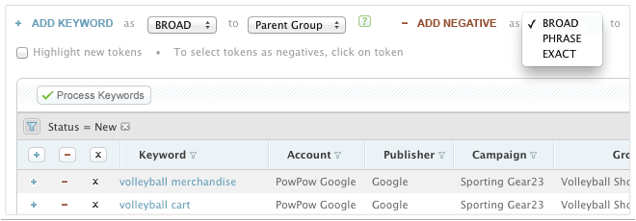
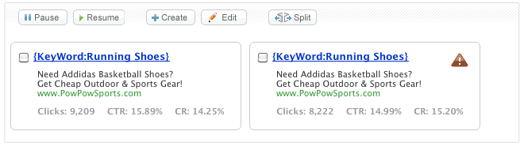
Tool Provider Services - Campaign Set up and Management
Account uploads / downloads
Sourcing new keywords
Ad and landing page testing
Setting Targeting
Bid and budget optimization
Mobile management

Slide 9
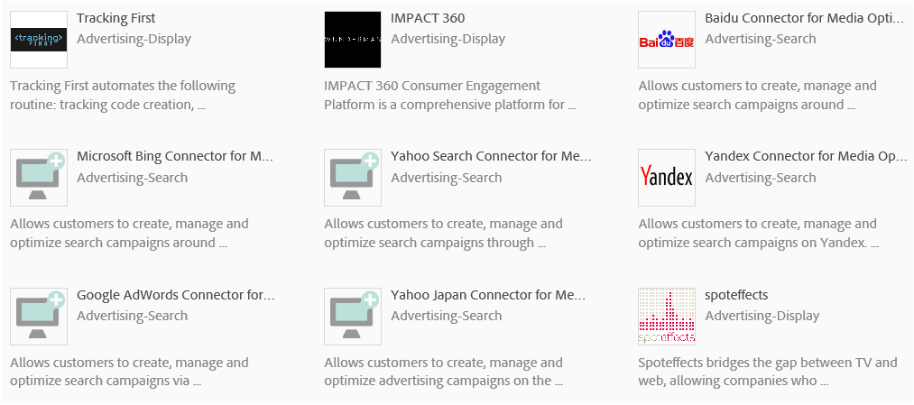
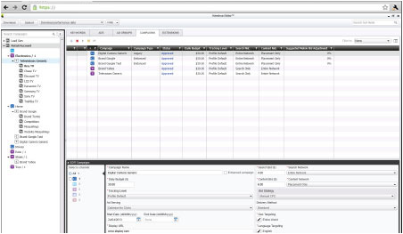
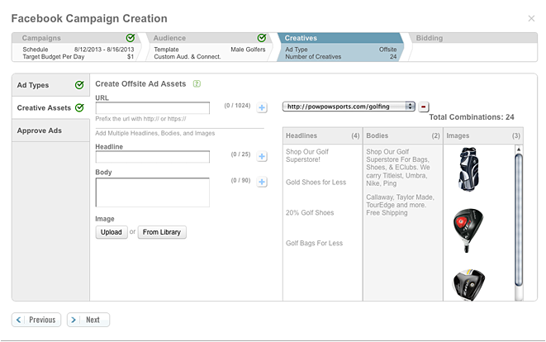
Tool Provider Services - Marketing Strategy Integration
Global Integration
Platform Integration
Bing
Google
Facebook etc.
Media Integration
Search
Display
Social
Cross channel

Slide 10
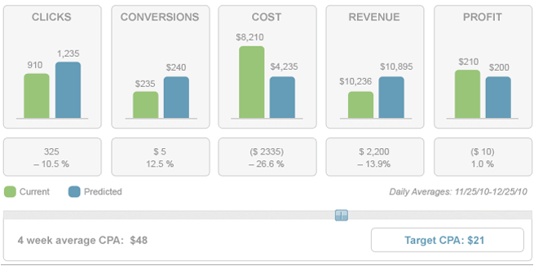
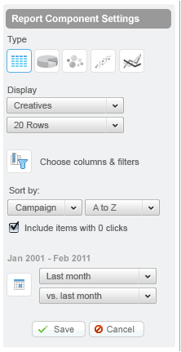
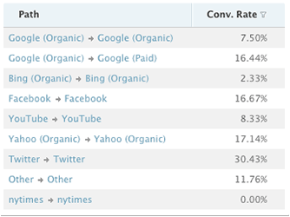
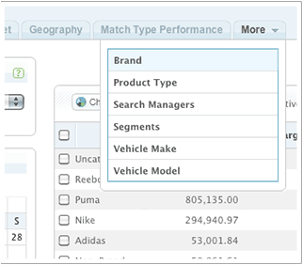
Tool Provider Services - Reporting and Tracking
Conversion tracking
Reporting dashboards
Product/audience segmentation
Cross platform analytics

Slide 11
Choosing a Tool Provider
Cost – How do Tool Providers make money?
Media fees: Usually the largest advertisers pay anywhere from .5% to 1.5%, and smaller advertisers pay more (3-4%)
Flat fee: TPs that focus on SMBs introduce a flat fee model of $100-$200 a month based on what features and client support the advertiser asks for
Set Up Fee: (negotiable)
Monthly Licensing Fee: (negotiable)
Internal strategy
Media mix
Platform prioritization
Market segment
Level of support required
Internal Account Management teams
Level of granularity required
Feature sets and whether to cherry pick features
Eg. Using Kenshoo bid management but Marin reporting

Slide 12
Appendix

Slide 13
Tool Providers – Useful Info
Dev Tokens- DevToken is a ID given to a developer, which provides access to Bing API services
1-to-Many Relationships – One account can be linked to multiple Tool Providers or Dev Tokens
Teams Involved- Ecosystem team primarily deals with Tool providers
KPIs and Reporting Complexity
KPI- Impressions, Clicks, Revenue
Reporting complexity – performance will be Duplicated at Account- Tool Provider level, As one accounts can be linked to multiple Tool Providers

Slide 14
Bing Ads API
The Bing Ads API enables advertiser to programmatically access a subset of the search advertising features that are available to users of the Bing Ads web application
For example, advertisers can use the API to create accounts, campaigns, ads, and keywords. They can also research historical and suggested keyword bids, and get performance reports that can be used to optimize the campaigns
For advertisers placing a large number of ads or developers building advertising tools, the Bing Ads API provides a programmatic interface to Bing Ads
Using the Bing Ads API is the most efficient way to manage many large campaigns or to integrate your marketing with other in-house systems
The Bing Ads API also supports multiple customer accounts making it easy for ad agencies to manage campaigns for many clients

Slide 15
Feed Managers
Feed Managers help retail based advertisers manage, at scale, the ability to syndicate, automate, optimize and analyze their product feeds and campaigns across multiple shopping channels.
There are two types of Feed Managers
Feed Management
Product Feed Management
Campaign Management
Process of creating, sending and updating product feed data (i.e. title, description, price, image URL, etc.)
Create, manage and optimize shopping campaigns and product groups. Including budget and bid management.
Common feed management tools:
FTP | File Transfer Protocol
Content API | Programmatically create, update and manage BMC store data
Campaign Management tools:
API = Application Programming Interface
Bing Ads UI
Bing Ads Editor

Slide 16





Feed Managers – Top 5
Feed Manager | Location | Feed Management | Campaign Management | BSC Ready?
 | Pittsburgh, PA | Yes - FTP | Yes | Yes
 | Charlottesville, VA | Yes - FTP | Yes | Yes
 | Seattle, WA | Yes – FTP & API | Yes | Yes
 | Morrisville, NC | Yes – FTP & API | Yes | Yes
 | Los Angeles, CA | Yes - FTP | Yes | In progress

